Slide 1


Intro to .NET and C# - part 2
Speaker:
Ivan Hlabets

Slide 2

Agenda
Exceptions
Base interfaces
Collections
Generics
Delegates Func<T> and Action<T>
Anonymous classes and methods
Lambda and predicate
LINQ
Extension methods
Common useful classes

Slide 3
Exceptions
Exceptions is a problem that arises during the execution of a program.
C# exception handling is built upon four keywords: try, catch, finally, and throw.
try − A try block identifies a block of code for which particular exceptions is activated. It is followed by one or more catch blocks.
catch − A program catches an exception with an exception handler at the place in a program where you want to handle the problem. The catch keyword indicates the catching of an exception.
finally − The finally block is used to execute a given set of statements, whether an exception is thrown or not thrown. For example, if you open a file, it must be closed whether an exception is raised or not.
throw − A program throws an exception when a problem shows up. This is done using a throw keyword.

Slide 4
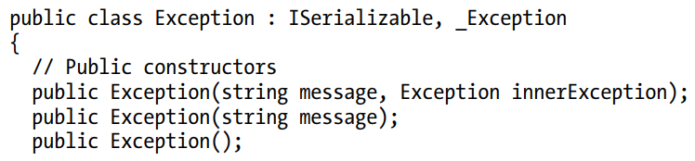
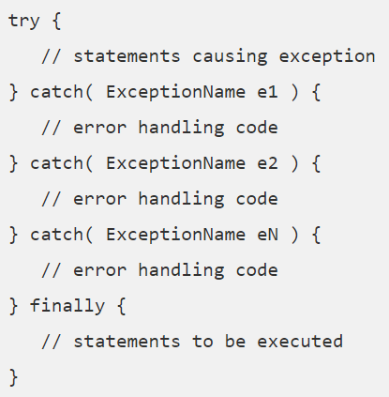
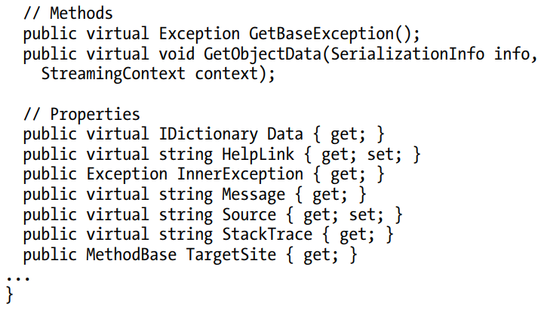
Structure of the exception

Slide 5
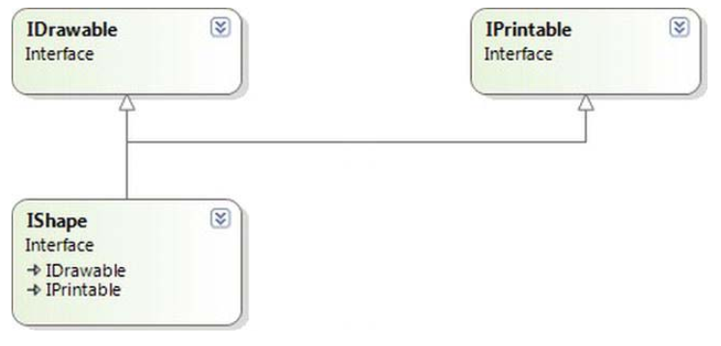
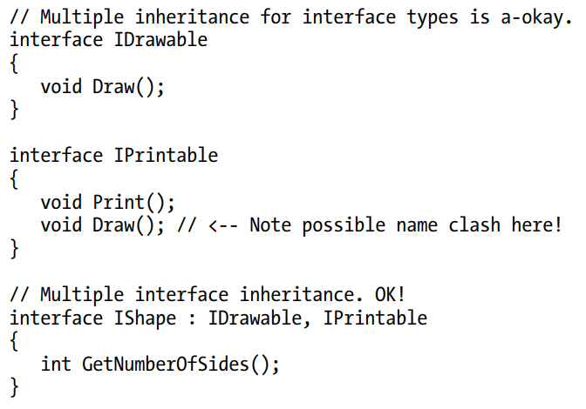
Multiple Inheritance with Interface types

Slide 6
Base interfaces
- ICloneable
- IEnumerable
- IEnumerator
- IComparable
- IComparer
- IEquatable

Slide 7
Collections
Collections is a way to create and manage a group of related objects.
Arrays are most useful for creating and working with a fixed number of strongly-typed objects. For information about arrays, see Arrays.
Collections provide a more flexible way to work with groups of objects. Unlike arrays, the group of objects you work with can grow and shrink dynamically as the needs of the application change. For some collections, you can assign a key to any object that you put into the collection so that you can quickly retrieve the object by using the key.
A collection is a class, so you must declare an instance of the class before you can add elements to that collection.
Types:
nongeneric
- generic

Slide 8
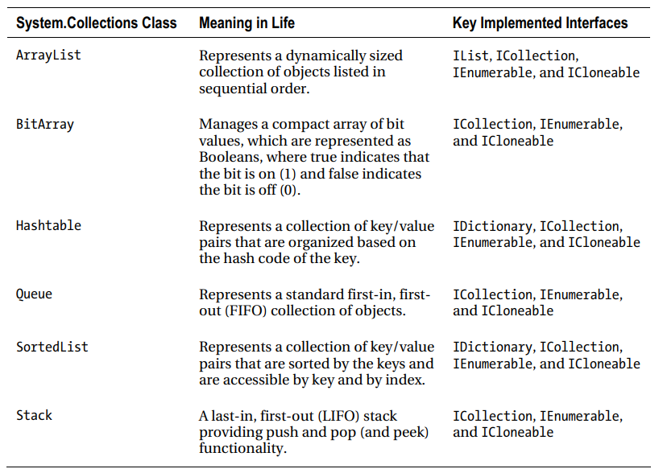
Nongeneric collections

Slide 9
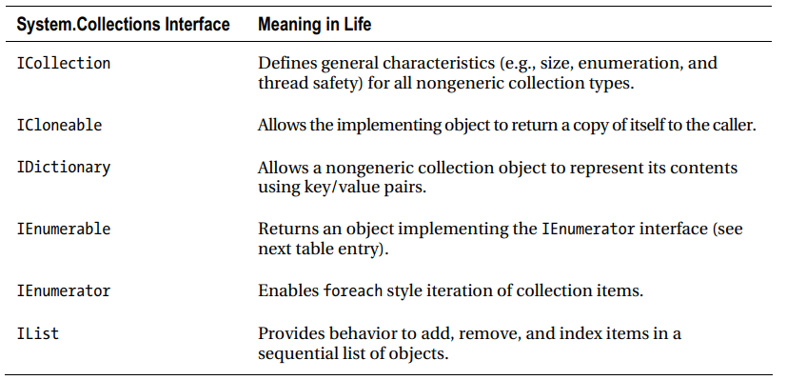
Key interface for nongeneric collections

Slide 10
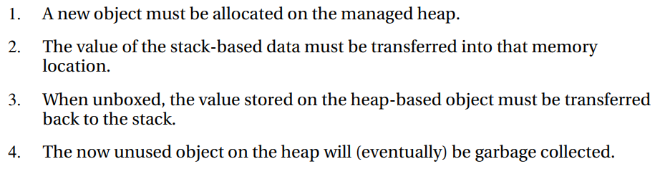
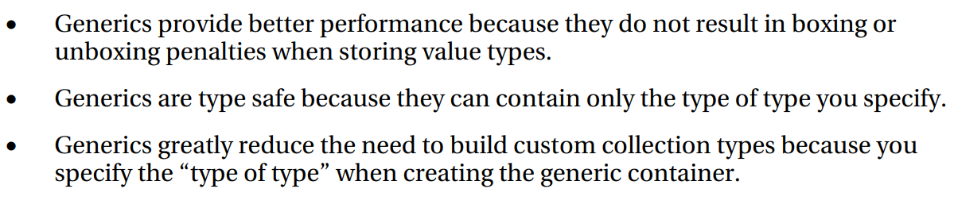
Nongeneric vs Generic
Issues with nongeneric collections:
Benefits of generic collections:

Slide 11
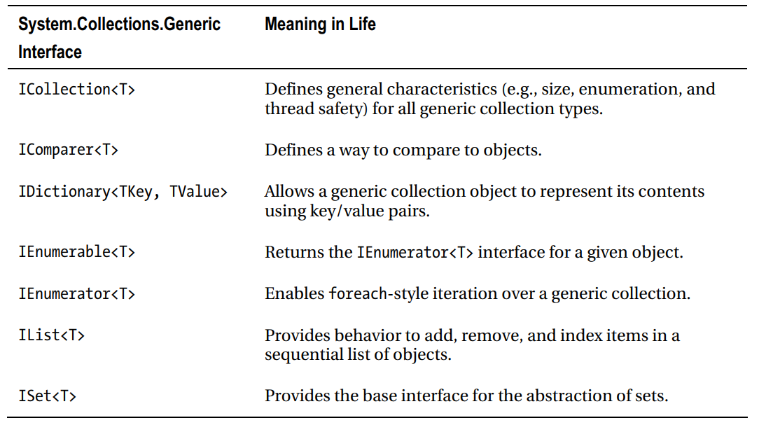
Key interface for generic collections

Slide 12
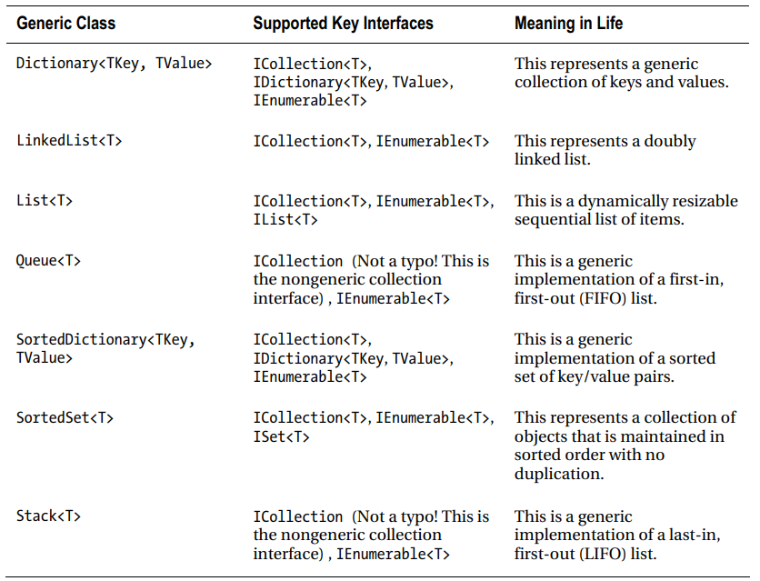
Generic collections

Slide 13
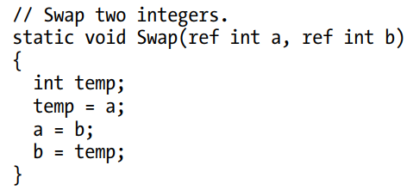
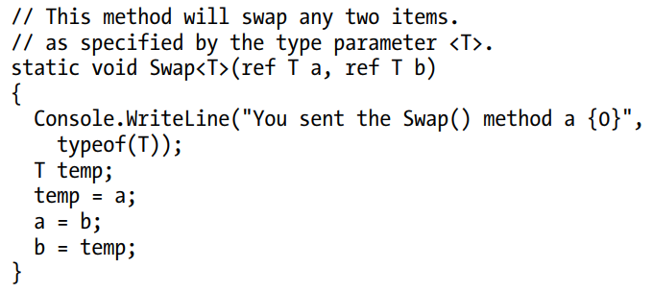

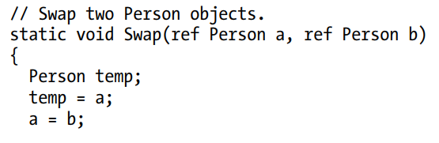
Generics

Slide 14
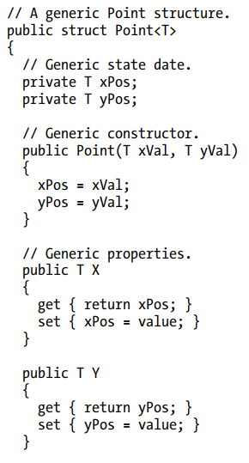
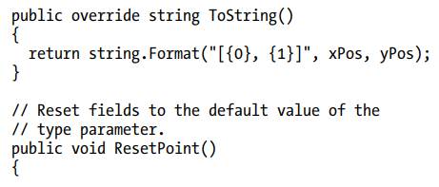

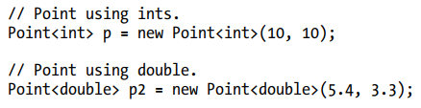
Generics

Slide 15
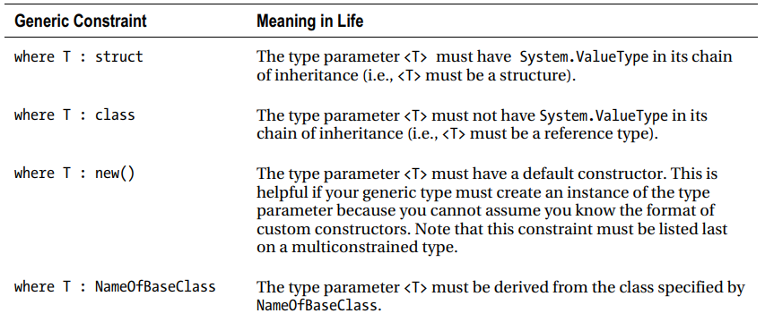

Constraining type parameters

Slide 16


Delegates Func<> and Action<>
When you want to use delegates to enable callbacks in
your applications, you typically follow the steps shown here:
• Define a custom delegate that matches the format of the method being pointed to.
• Create an instance of your custom delegate, passing in a method name as a constructor argument.
• Invoke the method indirectly, via a call to Invoke() on the delegate object.
Instead of this you can use existed Action<> and Func<> delegates.

Slide 17
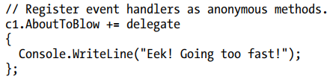

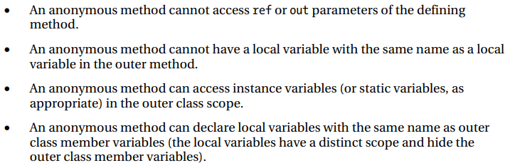
Anonymous methods

Slide 18

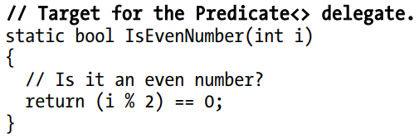



Lambda expression

Slide 19
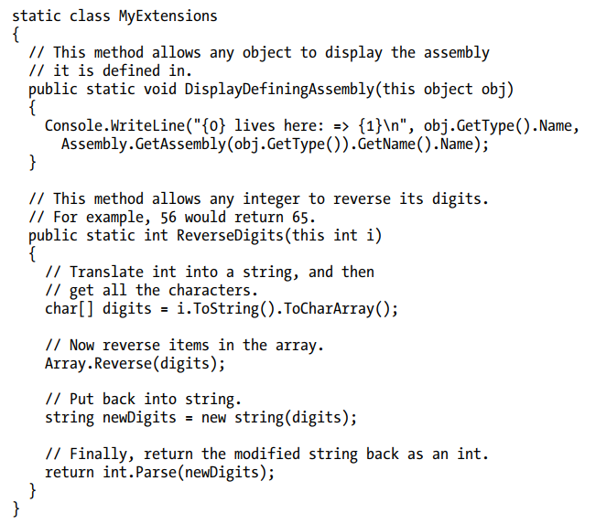
Extension methods
NET 3.5 introduced the concept of extension methods, which allow you to add new methods or properties to a class or structure, without modifying the original type in any direct manner.

Slide 20
LINQ
The Language Integrated Query (LINQ) technology set, introduced initially in .NET 3.5, provides a concise, symmetrical, and strongly typed manner to access a wide variety of data stores.
Using LINQ, you can build any number of expressions that have a lookand-feel similar to that of a database SQL query.
Specifically, the C# language uses the following core LINQ-centric features:
• Implicitly typed local variables
• Object/collection initialization syntax
• Lambda expressions
• Extension methods
• Anonymous types

Slide 21
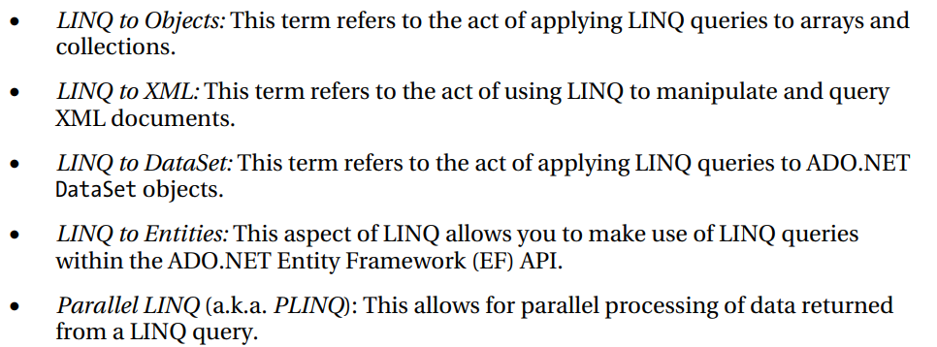
LINQ

Slide 22
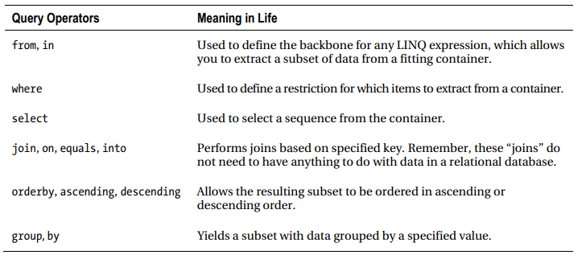
LINQ

Slide 23
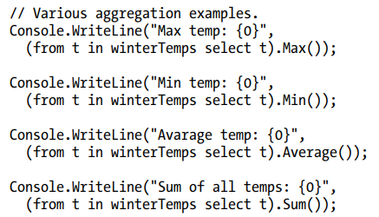
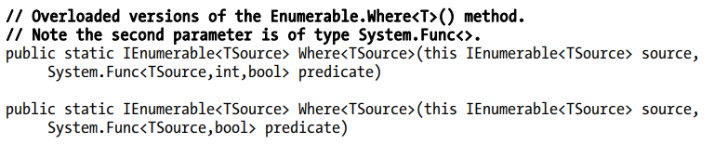
LINQ

Slide 24

Thank you!

